Slide 1
Black-Scholes Model
It was published in 1973 by Fisher Black, Robert Merton and Myron Scholes
~ they were constructed a model that can yield the V(S,t) option
price when t<T
THEY SHOWED THAT COMBINING RISKY ASSETS
CAN ELIMINATE RISK ITSELF !!!
Modern Portfolio Theory is about including several stocks in
a portfolio in order to reduce unsystematic risk
CAPM is about β: because we can eliminate unsystematic risk, the
only relevant risk is market risk
~ market risk cannot be diversified away !!!
Market-neutral strategyies: delta-hedging and pairs-trading
can eliminate all risk !!!

Slide 2
Black-Scholes Model
The V(S,t,...) value of an option is a function of various parameters
V( S , t , σ , μ , E , T , r )
stock price and time
are variables
parameter associated with
risk-free rate
volatility and mean are
parameters associated
with the stock price
strike price and expiry
are parameters associated
with the given option

Slide 3
Black-Scholes Model
Call option: this is the right to buy a particular asset (stock) for an agreed
amount at a specific time in the future
call option will rise in value if the underlying asset rises and
fall if the asset falls
WHY? Of course, the greater the value of S(t) stock, the greater
the payoff at T expiry
POSITIVE CORRELATION BETWEEN TWO ASSETS !!!

Slide 4
Black-Scholes Model
Put option: this is the right to sell a particular asset (stock) for an agreed
amount at a specific time in the future
NEGATIVE CORRELATION BETWEEN TWO ASSETS !!!
we can exploit these correlations to end up with a
rather special portfolio
π = V(S,t) - 𝛥S
long position
short position
This special π portfolio contains a long position in the V(S,t) option
and a short position in the S(t) underlying stock
What is 𝛥? We short just some quantity of the underlying

Slide 5
Black-Scholes Model
Assumption: the underlying asset follows a lognormal random walk
dS = 𝝻 S dt + 𝞂 S dX
What about the change in the portfolio’s value?
The π portfolio changes from time t to t+dt: first of due to change in
the V(S,t) option value + because of the change in the S(t)
underlying asset
dπ = dV(S,t) - 𝛥dS
How to deal with these changes? With the help of Ito’s lemma
we can handle these changes

Slide 6












Black-Scholes Model
2
$$\frac{∂V}{∂t}$$ dt
$$\frac{∂V}{∂S}d$$S
$$\frac{∂ V}{∂S}d$$t
+
+
$$\frac{1}{2}$$ σ S
dV(S,t) =
2
2
2
2
$$\frac{∂V}{∂S}d$$S
$$\frac{∂ V}{∂S}d$$t
$$\frac{∂V}{∂t}$$ dt
+
+
$$\frac{1}{2}$$ σ S
+
2
2
dπ = - 𝛥dS
2
2
$$\frac{∂V}{∂S}$$
$$\frac{∂ V}{∂S} )d$$t
( $$\frac{∂V}{∂t}$$
$$\frac{1}{2}$$ σ S
+
+
+
2
2
dπ = ( - 𝛥)dS
2
deterministic part
stochastic part

Slide 7




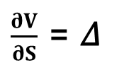
Black-Scholes Model
Delta-hedging:
The change in the portfolio has a deterministic part and a
stochastic part
2
$$\frac{∂V}{∂S}$$
$$\frac{∂ V}{∂S} )d$$t
( $$\frac{∂V}{∂t}$$
$$\frac{1}{2}$$ σ S
+
+
+
2
2
dπ = ( - 𝛥)dS
2
deterministic part
stochastic part
$$\frac{∂V}{∂S}$$ = 𝛥
if we choose delta like this, risk
is reduced to zero
any elimination in randomness is called hedging
delta hedging: the perfect elimination of risk because of
exploiting the correlation between two assets
~ it is an example of dynamic hedging

Slide 8
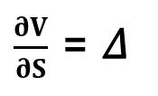




Black-Scholes Model
Delta-hedging:
$$\frac{∂V}{∂S}$$ = 𝛥
„dynamic delta-hedging”
Of course this 𝛥 is changing all the time: the perfect hedge must be
continually rebalanced
2
$$\frac{∂V}{∂S}$$
$$\frac{∂ V}{∂S} )d$$t
( $$\frac{∂V}{∂t}$$
$$\frac{1}{2}$$ σ S
+
+
+
2
2
dπ = ( - 𝛥)dS
2
deterministic part
stochastic part
so we just have to deal with the
deterministic part exclusively

Slide 9



Black-Scholes Model
No arbitrage principle:
We can use dynamic hedging to eliminate all the risk
~ we have just the deterministic part
2
$$\frac{∂ V}{∂S} )d$$t
( $$\frac{∂V}{∂t}$$
$$\frac{1}{2}$$ σ S
+
+
2
2
dπ =
2
This change is completely riskless: but risk-free asset has
something to do with r risk-free rate
The risk-free dπ change must be the same as the growth we would get if we
lend the same amount of cast to a bank:
dπ = r π dt
„no arbitrage principle”

Slide 10
Black-Scholes Model
No arbitrage principle:
Let’s consider it is not true: why can we make a riskless profit?
Arbitrage: when the investor can make riskless money !!!
if we can get a greater return with the delta-hedged portfolio: we
could borrow money from the bank ... pay interest at rate r
invest that money into risk-free option/stock portfolio
and we could make a profit !!!
usually we can assume there are no arbitrage opportunities
OR if there are ... just for a very short time !!!

Slide 11








Black-Scholes Model
2
$$\frac{∂V}{∂S}$$
$$\frac{∂ V}{∂S} )d$$t = r ( V – S ) dt
( $$\frac{∂V}{∂t}$$
$$\frac{1}{2}$$ σ S
+
+
2
2
2
2
$$\frac{∂V}{∂S}$$
$$\frac{∂ V}{∂S}$$– r S
$$\frac{∂V}{∂t}$$
+
$$\frac{1}{2}$$ σ S
+
2
2
- r V = 0
2
„Black-Scholes equation”
it is a parabolic partial differential equation
linear: so the sum of the solutions is also a solution
financial equations are usually parabolic: they are related to heat
and diffusion equations of physics !!!

Slide 12


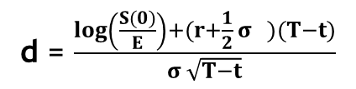

Black-Scholes Model
Solution to Black-Scholes equation: no dividend yields on the underlying
$$_{−∞}^{x}{e^{−\frac{z}{2}}}$$
$$\frac{1}{\sqrt{2π}}$$
2
N(x) =
dz
standard normal distribution
CALL OPTION PUT OPTION
-r(T-t)
-r(T-t)
S(0)N(d ) – E e N(d )
-S(0)N(-d ) + E e N(-d )
1
2
1
2
d = $$\frac{\log\left(\frac{S(0)}{E}\right)+(r+\frac{1}{2} σ )(T−t)}{σ \sqrt{T−t}}$$
2
1
d = d – σ $$\sqrt{T−t}$$
2
1

Slide 13

The Greeks
1.) Delta: 𝛥
The delta of an option/portfolio is the sensitivity of the
option/portfolio to the underlying
𝛥$$= \frac{∂V}{∂S}$$
~ the delta of a portfolio is the sum of deltas of
all individual positions
it is important when dealing with delta-hedging
We can eliminate risk if we make sure delta is
equals to the derivative !!!

Slide 14

The Greeks
2.) Gamma: 𝛤
The gamma of an option/portfolio is second derivative of the
position with respect to the underlying
2
𝛤$$= \frac{∂ V}{∂S }$$
2
~ basically it is the sensitivity of 𝛥 delta
gamma is a measure of how often a position must be rehedged in
order to maintain a delta-neural position
Delta-neutral: it means the portfolio value remains unchanged when small
changes occur in the value of the underlying
This is what Black-Scholes model about !!!

Slide 15


The Greeks
3.) Theta: 𝛩
Theta is the rate of change of the option price with time:
𝛩$$=\frac{∂V}{∂t}$$
4.) Vega:
Some models rely heavily on the volatility so it may be important
to monitor the change according to volatility
$$\frac{∂V}{∂σ}$$

Slide 16
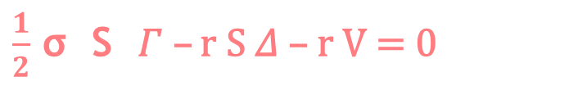

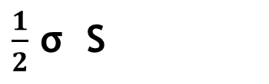
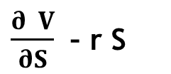

The Greeks
Black-Scholes formula:
2
$$\frac{∂V}{∂S}$$
$$\frac{∂ V}{∂S}$$– r S
$$\frac{∂V}{∂t}$$
$$\frac{1}{2}$$ σ S
+
+
2
2
- r V = 0
2
theta
gamma
delta
$$\frac{1}{2}$$ σ S 𝛤 – r S 𝛥 – r V = 0
2
𝛩 +
2
„Black-Scholes formula with the greeks”

Slide 17
Implied Volatility
Most of the parameters are straightforward when dealing
with the Black-Scholes model
V(S,t,σ,μ,E,T,r)
HOW TO CALCULATE VOLATILITY?
→ volatility has something to do with the option price
What volatility should the investor use to get the correct market price
of the given option? This is called implied-volatility !!!
We have to solve the Black-Scholes equation:
V (S,t,σ,μ,E,T,r) = known value
Black-Scholes
We can use Newton-Raphson method to find σ

Slide 18
Black-Scholes Model
How to make money with Black-Scholes model?
several investors use these kinds of models to
eliminate risk
So calculate the greeks to hedge a given portfolio
→ you can use Black-Scholes model to find mispriced options
in the market
~ you can buy or sell accordingly to make a profit

Slide 19
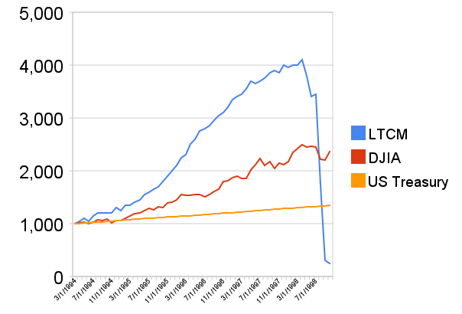
Long Term Capital Management (LTCM)
this hedge fund was founded in 1994 by the former vice-chairman
of Salomon Brothers – John W. Meriwether
lots of members were academics: such as the Nobel-prize winner
Myron Scholes and Robert C. Merton
~ they used quite complex models such as paris-trading or
Black-Scholes model !!!

Slide 20
Long Term Capital Management (LTCM)
Because of the asian financial crisis in 1997 and
the russian financial crisis in 1998 LTCM collapsed
What as the key of success?
The quants in LTCM tried to hedge market risk
There are two approaches: Black-Scholes model
and pairs-trading strategy
MARKET-NEUTRAL STRATEGIES !!!
market-neutral strategy tries to profit from both increasing
and decreasing stock prices
usually combining long and short positions
in different assets

Slide 21
Long Term Capital Management (LTCM)
Pairs-trading strategy:
Combining long and short positions in a pair of highly correlated
financial instruments (such as stocks)
~ it is a form of statistical-arbitrage strategy
developed in the 1980s
If the correlation between the two stocks weakens: investor should long the
underperforming stock and short the outperforming stock → because they are
expected to converge in the future
For example: CocaCola and Pepsi
~ they have similar business idea so they are similar

Slide 22
Long Term Capital Management (LTCM)
Pairs-trading strategy:
Combining long and short positions in a pair of highly correlated
financial instruments (such as stocks)
~ it is a form of statistical-arbitrage strategy
developed in the 1980s
S(t)
Pepsi (PEP) and CocaCola (KO) are companies
with similar products: they are historically correlated
If PEP goes up a significant amount while KO stays the same,
pairs trader should buy KO stock and sell PEP stock
~ so the trader assumes the companies would return
to their historical balance point
Coca-Cola
Pepsi
t

